Slide 1
Open Security Summit 2020
Pre Conference Training
A glorious TWO HOUR long rant by @catswetel

Slide 2
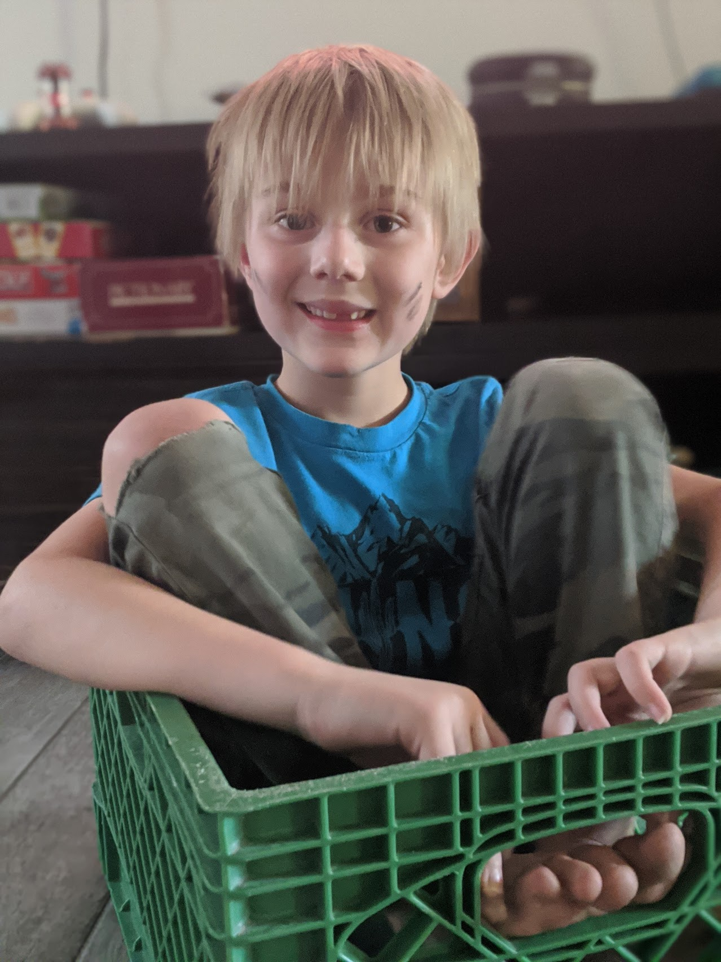
WARNING

Slide 3
WARNING
Not a security expert

Slide 4
WARNING
None of this is Wardley Approved

Slide 5
Nope
Not here to teach you about
how to use online tools.

Slide 6
Yep!
Intro to Wardley Maps
Some tips and tricks for getting started
Unique perspective

Slide 7
WARNING
Lots of Star Trek

Slide 8
Who’s heard of
Wardley Maps?
Use the chat
and/or reactions!
0 - Never
1 - Heard of them, but don’t know what they are
2 - Know what they are, never done one
3 - Have created a map before
4 - Have created maps, used doctrine, etc

Slide 9
“I’m excited to create my first map!”
@CATSWETEL
Notes:
But I tell her, not everyong is doing this. Actually my anecdata says that very few people are actually doing this. I told her the things I hear most often when I get to talking to someone about mapping is, “I’m excited to create my first map,” or “I think I would need to use mapping more to understand it or really get the benefits.”

Slide 10
What is a Wardley Map?
A tool for thinking about
the evolution of value chains

Slide 11
What is Wardley Mapping?
A set of tools for navigating the evolution of sociotechnical systems.

Slide 12
Wardley Map
Wardley Mapping
A tool for thinking about
the evolution of value chains
A set of tools for navigating the evolution of sociotechnical systems.

Slide 13
Value Chain

Slide 14

Value Chain
Klingon tea ceremony
A friend!
Poetry
Cup of tea
Antidote
Doctor
Poison flowers
Hot water
Replicator

Slide 15
Klingon tea ceremony
A friend!
Poetry
Cup of tea
Poison flowers
Antidote
Hot water
Doctor
Replicator
Genesis | Custom | Product | Commodity

Slide 16
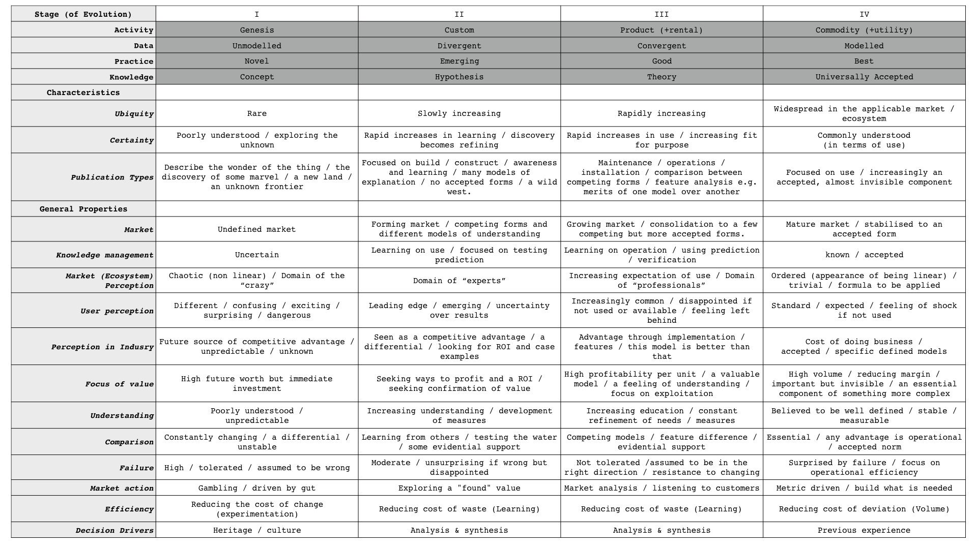
@swardley
@swardley

Slide 17
@swardley
@swardley

Slide 18
@swardley
@swardley

Slide 19
@swardley
@swardley

Slide 20
Klingon tea ceremony
A friend!
Poetry
Cup of tea
Poison flowers
Antidote
Hot water
Doctor
Replicator
Genesis | Custom | Product | Commodity

Slide 21

Klingon tea ceremony
A friend!
Poetry
Cup of tea
Poison flowers
Antidote
Hot water
Doctor
Replicator
Genesis | Custom | Product | Commodity

Slide 22
Klingon tea ceremony
A friend!
Poetry
Cup of tea
Poison flowers
Antidote
Hot water
Doctor
Replicator
Genesis | Custom | Product | Commodity

Slide 23
All my wisdom is
Star Trek wisdom

Slide 24
“Mapping is an experience best shared.”
@catswetel after Worf, Son of Mogh

Slide 25
The map is not the thing.
@CATSWETEL

Slide 26

“I understand the externals, not the mysteries.”
Dr Pulaski

Slide 27
Meaning
Social
Practice
Theory
Material
Skills
The Dynamics of
Social Practice
Elizabeth Shove

Slide 28
Klingon tea ceremony
A friend!
Poetry
Cup of tea
Poison flowers
Antidote
Hot water
Doctor
Replicator
Genesis | Custom | Product | Commodity

Slide 29
“Dying is an experience best shared.”
@catswetel after Worf, Son of Mogh

Slide 30
Klingon tea ceremony
A friend!
Poetry
Cup of tea
Poison flowers
Antidote
Hot water
Doctor
Replicator
Genesis | Custom | Product | Commodity

Slide 31
Meaning
Social
Practice
Theory
Material
Skills
The Dynamics of
Social Practice
Elizabeth Shove

Slide 32
Klingon tea ceremony
A friend!
Poetry
Cup of tea
Poison flowers
Antidote
Hot water
Doctor
Replicator
Genesis | Custom | Product | Commodity

Slide 33
Meaning
Social
Practice
Theory
Material
Skills
The Dynamics of
Social Practice
Elizabeth Shove

Slide 34
https://maturitymapping.com/

Slide 35
Settler

Slide 36
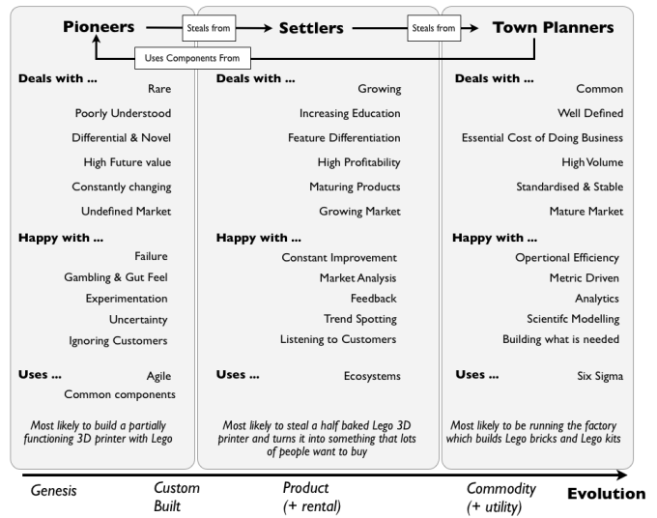
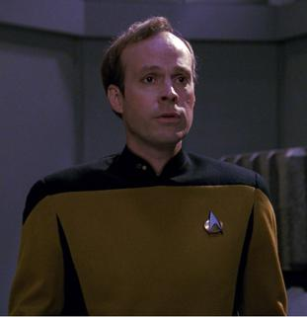


Slide 37
DR
Primary
Target
Validation of Services
Backups / Secondary
Activation
Cluster Management
Restore
Persistent storage
Routes
Synthetic Monitoring
Keys
Genesis | Custom | Product | Commodity

Slide 38

DR
Primary
Target
Validation of Services
Backups / Secondary
Activation
Cluster Management
Restore
Persistent storage
Routes
Synthetic Monitoring
Keys
Genesis | Custom | Product | Commodity

Slide 39
How do WE treat this component vs how does the rest of the industry treat this component?
DR
Primary
Target
Validation of Services
Backups / Secondary
Activation
Cluster Management
Restore
Persistent storage
Routes
Synthetic Monitoring
Keys
Genesis | Custom | Product | Commodity

Slide 40
How do WE treat this component vs how does the rest of the industry treat this component?
DR
Primary
Target
Validation of Services
Backups / Secondary
Activation
Cluster Management
Restore
Persistent storage
Routes
Synthetic Monitoring
Keys
Genesis | Custom | Product | Commodity

Slide 41
DR
Primary
Target
Validation of Services
Backups / Secondary
Activation
Cluster Management
Restore
Persistent storage
Routes
Synthetic Monitoring
Keys
Genesis | Custom | Product | Commodity

Slide 42

DR
Primary
Target
Validation of Services
Backups / Secondary
Activation
Cluster Management
Restore
Persistent storage
Routes
Synthetic Monitoring
Keys
Genesis | Custom | Product | Commodity

Slide 43
Hey friend! How are you doing secrets management?
DR
Primary
Target
Validation of Services
Backups / Secondary
Activation
Cluster Management
Restore
Persistent storage
Routes
Synthetic Monitoring
Keys
Genesis | Custom | Product | Commodity

Slide 44
DR
Primary
Target
Validation of Services
Backups / Secondary
Activation
Cluster Management
Restore
Persistent storage
Routes
Synthetic Monitoring
Keys
Genesis | Custom | Product | Commodity

Slide 45

DR
Primary
Target
Validation of Services
Backups / Secondary
Activation
Cluster Management
Restore
Persistent storage
Routes
Synthetic Monitoring
Keys
Genesis | Custom | Product | Commodity

Slide 46
DR
Primary
Target
Validation of Services
Backups / Secondary
Activation
Cluster Management
Restore
Persistent storage
Routes
Synthetic Monitoring
Keys
Genesis | Custom | Product | Commodity

Slide 47

DR
Security
Strategic Initiatives
Primary
Target
Validation of Services
Backups / Secondary
Activation
Cluster Management
Restore
Persistent storage
Routes
Synthetic Monitoring
Keys
Genesis | Custom | Product | Commodity

Slide 48
DR
Security & Compliance
Strategic Initiatives
Primary
Target
Validation of Services
Backups / Secondary
Activation
Cluster Management
Restore
Persistent storage
Routes
Synthetic Monitoring
Keys
Genesis | Custom | Product | Commodity

Slide 49
Crap at other things too

Slide 50
Learn More
https://learnwardleymapping.com/
https://maturitymapping.com/
https://onlinewardleymaps.com/
https://miro.com/templates/wardley-map/

